Slide 1
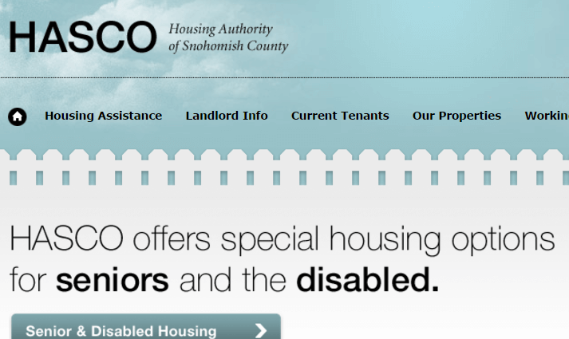
Housing Authority of Snohomish County Case Study
<ul>
<li>Affirma gathered detailed notes and addressed project requirements through questionnaires and interviews. During this phase, key business and design needs were identified and other requirements for implementation were addressed.</li>
<li>As part of their design phase, Affirma created wireframes for page layouts and design compositions for the home page, team sites and properties. Affirma also defined use cases, as well as mapped flow charts to best leverage the SharePoint platform.</li>
<li>All site and application development, such as the main landing page, department/team sites, property subsites and interior pages were completed per HASCO&rsquo;s specifications. A portal landing page was created that greets users with a series of links showing upcoming events, and recent company announcements.</li>
<li>Each page was created with a specially stylized header including the official HASCO logo, and links to the different department sites for intuitive navigation.</li>
<li>Each of the main department sites such as Teamsites, Workplaces and Properties, were also created with drop down links connected to them. For example, pages related to Accounting or Admin would fall under the Teamsites, while Properties included individual properties managed by HASCO.</li>
<li>At the end of each page, Affirma created a stylized footer including important information such as copyrights and privacy statements.</li>
<li>Permission setting guidance&rsquo;s were instituted and Affirma then performed all necessary testing, debugging, and deployment of the intranet portal and pages. Affirma also performed trainings and created administrative guides to educate future staff on best practices.</li>
<li>Finally, Affirma also provided project management, which included meeting scheduling and follow up, task assignments, budget monitoring and reporting, schedule monitoring, human resource management, risk identification and management and project team communication.</li>
</ul>
The Challenge
<p>The Housing Authority of Snohomish County (HASCO), an institution dedicated to providing affordable housing in Snohomish County, wanted to redesign the look and feel of their existing SharePoint intranet portal. HASCO wanted their SharePoint intranet to better reflect their identity of a community builder. HASCO is dedicated to improving the well-being of their communities through safe and affordable housing. HASCO wanted this mission to be visible from their intranet.</p>
<p>Affirma completed an initial design phase where they outlined several features that would help HASCO achieve their goals. Among the different features that Affirma would implement were an announcement section, as well as individual department sites. Affirma would also create a uniform page design to create a strong community identity.</p>
What We Did
Results
<p>HASCO completed their consultation with a fully live and functional SharePoint online portal. The new HASCO SharePoint portal includes features such as team sites, announcement pages, and interior page designs that help foster a sense of community. This aligns with HASCO&rsquo;s original stated project goals to bolster their mission identity and organization community through a redesigned SharePoint portal. HASCO finished the consultation emphatically satisfied with Affirma&rsquo;s performance and continues to contract with Affirma for projects.</p>

